Slide 1
Python Programming For Nanoparticle Characterization and Cell Test Output Analysis
Maya Oh CME 502 Final Project
Spring 2024
Notes:
Hi, I will be presenting the python programming for nanoparticle characterization and cell test output analysis.

Slide 2
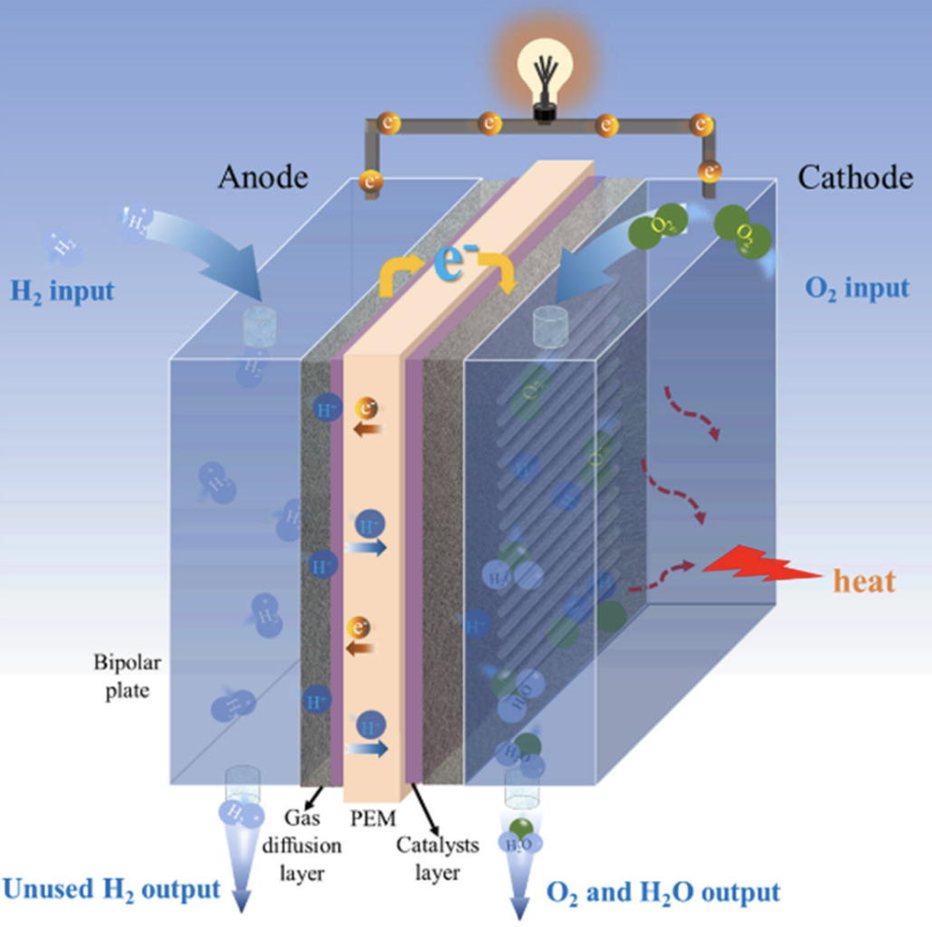
Introduction
Proton Exchange Membrane Fuel Cell (PEMFC)
Environmentally friendly electricity generator
Platinum as a catalyst for membrane in PEMFC
High production costs
CO poisoning
CO content in hydrogen fuel
Reduce cell potential and energy conversion efficiency
Notes:
[Given the growing concerns for environmental protection, the green energy industry is experiencing rapid growth, with a focus on developing eco-friendly technologies. One area of interest is fuel cells, which offer eco-friendly electricity generation without harmful byproducts.]
Proton Exchange Membrane Fuel Cells (PEMFCs) are one type of fuel cell that generates electricity from hydrogen gas, producing water as a byproduct. This can be a great option for eco-friendly technologies, but there are significant challenges to commercializing PEMFCs due to certain limitations.
Currently, the most common catalyst used in PEMFCs for electrochemistry is platinum, but it's quite expensive, and that makes it challenging to commercialize platinum-based fuel cells on an industrial scale.
Additionally, there are technical and financial challenges associated with producing pure hydrogen gas, and most hydrogen gas contains a certain amount of carbon monoxide (CO). Even small amounts of CO can contaminate the catalyst, leading to reduced cell potential and decreased energy conversion efficiency.

Slide 3
Research Topic
Using silver as a catalyst for Membrane
Determine a feasibility as an alternative to plain platinum
Characterization of Ag nanoparticles
X-ray Diffraction (XRD)
Isotherm graph
Analysis of power output from cell testing
Voltage and power density graph
Notes:
My research focused on exploring silver as a potential alternative to pure platinum to reduce costs in catalyst materials.
[The goal was to assess the feasibility of using silver as a catalyst alongside platinum to enhance fuel cell performance while reducing overall catalyst expenses.]
During the study, I synthesized silver nanoparticles (Ag NPs) in the lab and characterized them using techniques such as X-ray Diffraction (XRD) and isotherm analysis to identify the silver nanoparticles and monolayer formation.
With that, I analyzed the power output achieved by silver deposition to the membrane and compared it to the performance of the uncoated membrane to see the enhancement.

Slide 4
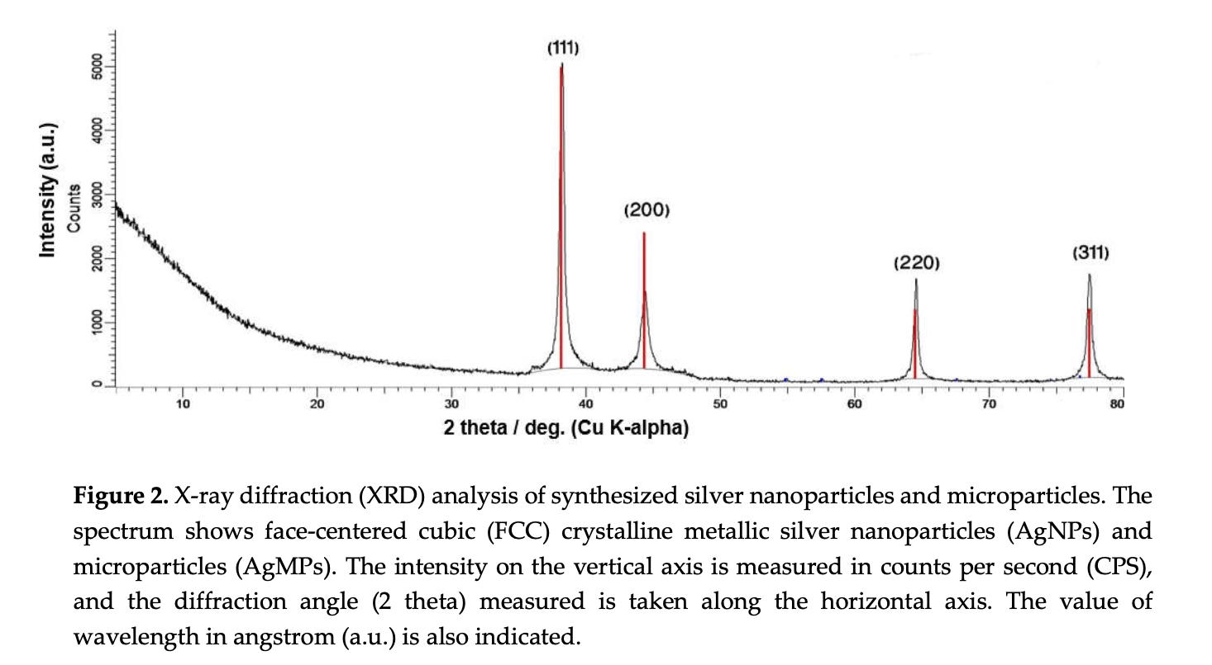
XRD: Crystal Classification
Identification of a crystal to determine if it is silver
Ag NP peaks (2Θ):
38.2 / 44.5 / 64.4 / 77.5
According to JCPDS / ICDD
Possible non-Ag NP peak:
Not reduced AgNO3 from synthesis
Notes:
To confirm the composition of the synthesized nanoparticles as silver, X-ray Diffraction (XRD) was employed due to the inability to visually confirm silver formation.
[In solid crystals, each material possesses a unique arrangement of crystal units, which is reflected in the corresponding peaks observed in XRD patterns. This allows for the classification of materials based on these patterns.]
To classify the synthesized particles, I utilized databases of standard XRD references such as JCPDS or ICDD. According to the JCPDS database, four major characteristic peaks for crystalline silver nanoparticles are at 38.2°, 44.5°, 64.4°, and 77.5° in the XRD pattern. By comparing these XRD peaks with the peaks obtained from my synthesized solution, I was able to confirm the presence of silver nanoparticles.

Slide 5
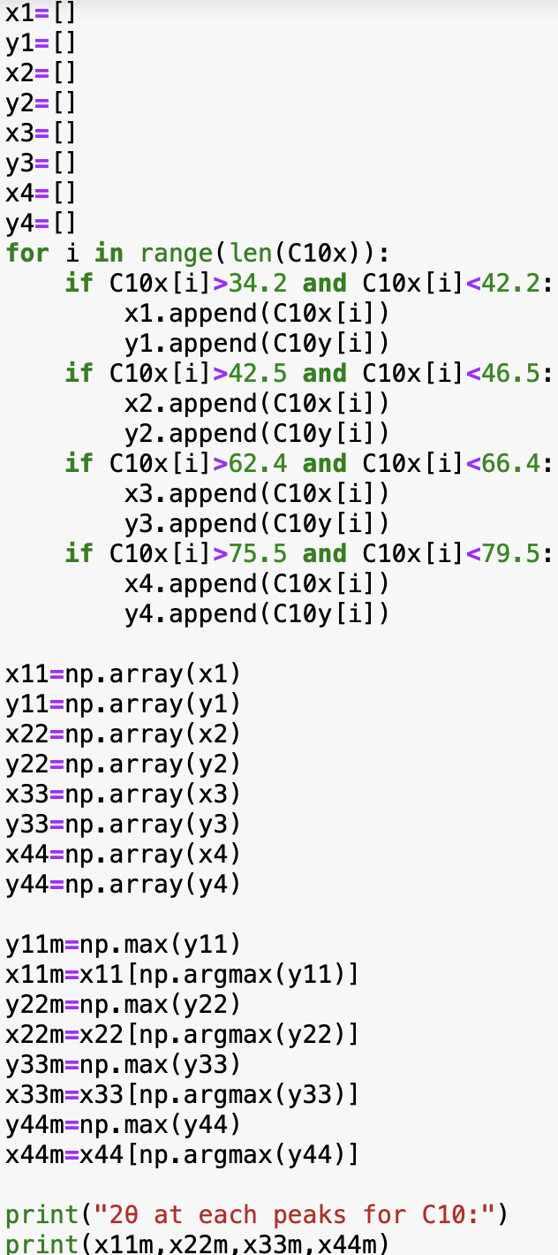
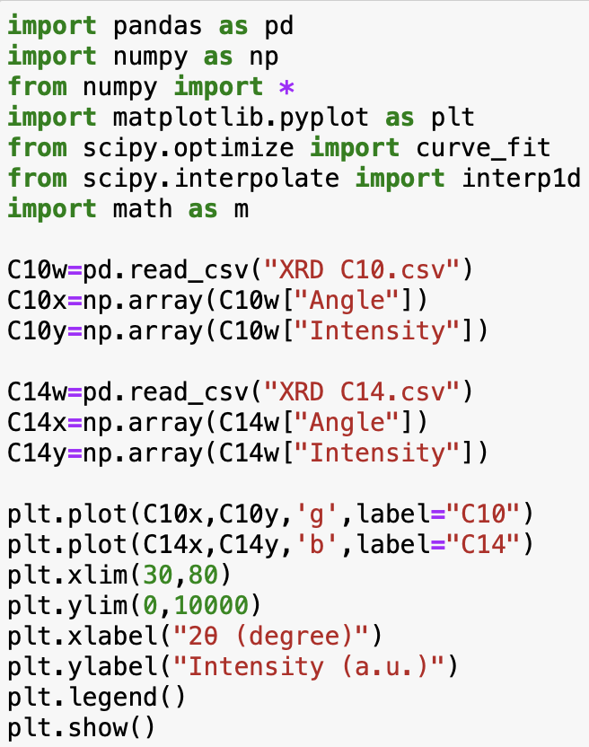
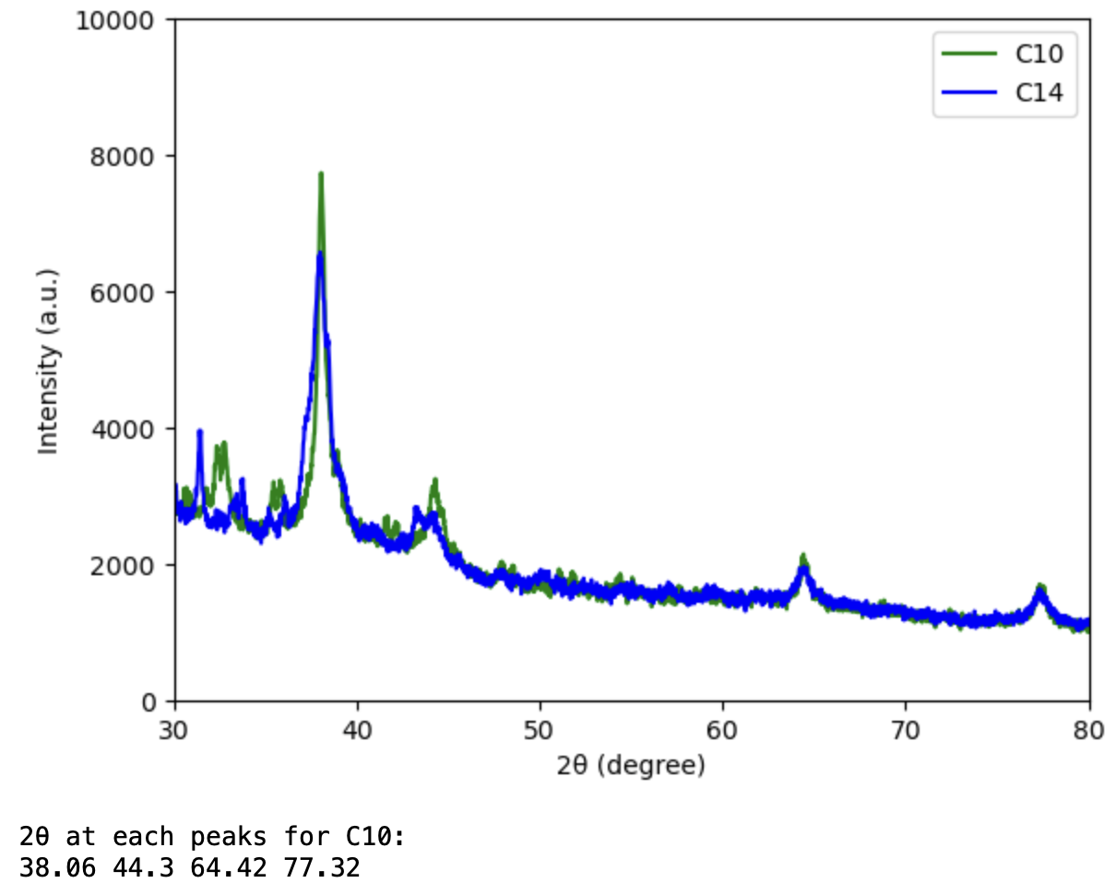
Notes:
I synthesized two sample of silver NPs with different stabilizers, C10 and C14. And I did XRD with those two solutions.
[C10 for 1-dodecanethiol and C14 for 1-tetradecanethol.]
The raw data was stored in a CSV file, which I imported and processed using the pandas. After separating the X (2-theta) and Y (intensity) values into numpy arrays, I plotted the XRD patterns for both samples.
To identify the most intense peaks corresponding to silver, I manually defined specific ranges of 2-theta values using for loops where silver peaks were expected. Within each range, I located the maximum intensity (Y value) and determined the corresponding 2-theta value for each peak.
Here, I got the results for the four major peaks of 2-theta for the C10 sample. The observed peaks aligned well with known silver diffraction data from reference sources, confirming the successful formation of silver nanoparticles..

Slide 6
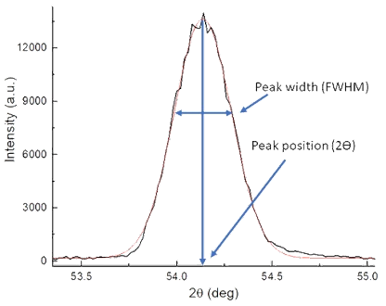
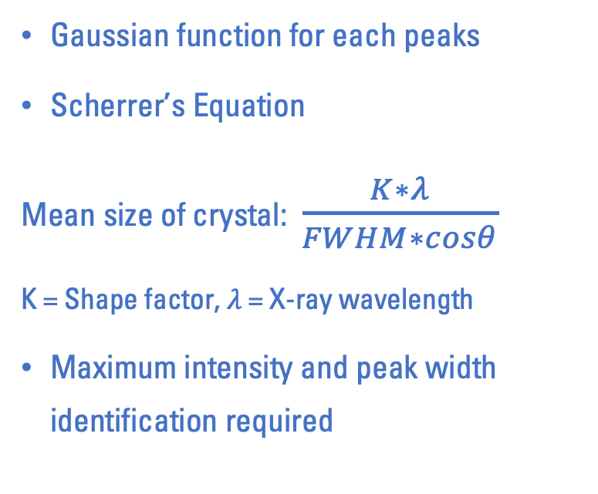
XRD: Size Determination
Gaussian function for each peaks
Scherrer’s Equation
Mean size of crystal: $\frac{K∗λ}{FWHM∗cosθ}$
K = Shape factor, $λ$ = X-ray wavelength
Maximum intensity and peak width identification required
Notes:
Additionally, I calculated the crystal size of the nanoparticles from the XRD data, as the size of the catalyst particles significantly impacts cell performance.
The mean size of crystals can be calculated from the most intense peaks in XRD using Scherrer's equation, [which is: ~~~~]
where K is the shape factor, which is 0.9 for silver,
lamda is the X-ray wavelength used in the XRD analysis,
FWHM is the Full Width at Half Maximum,
and theta is half of the x axis.
So the maximum intensity and the peak width at half of that maximum intensity was required for the size calculation.

Slide 7
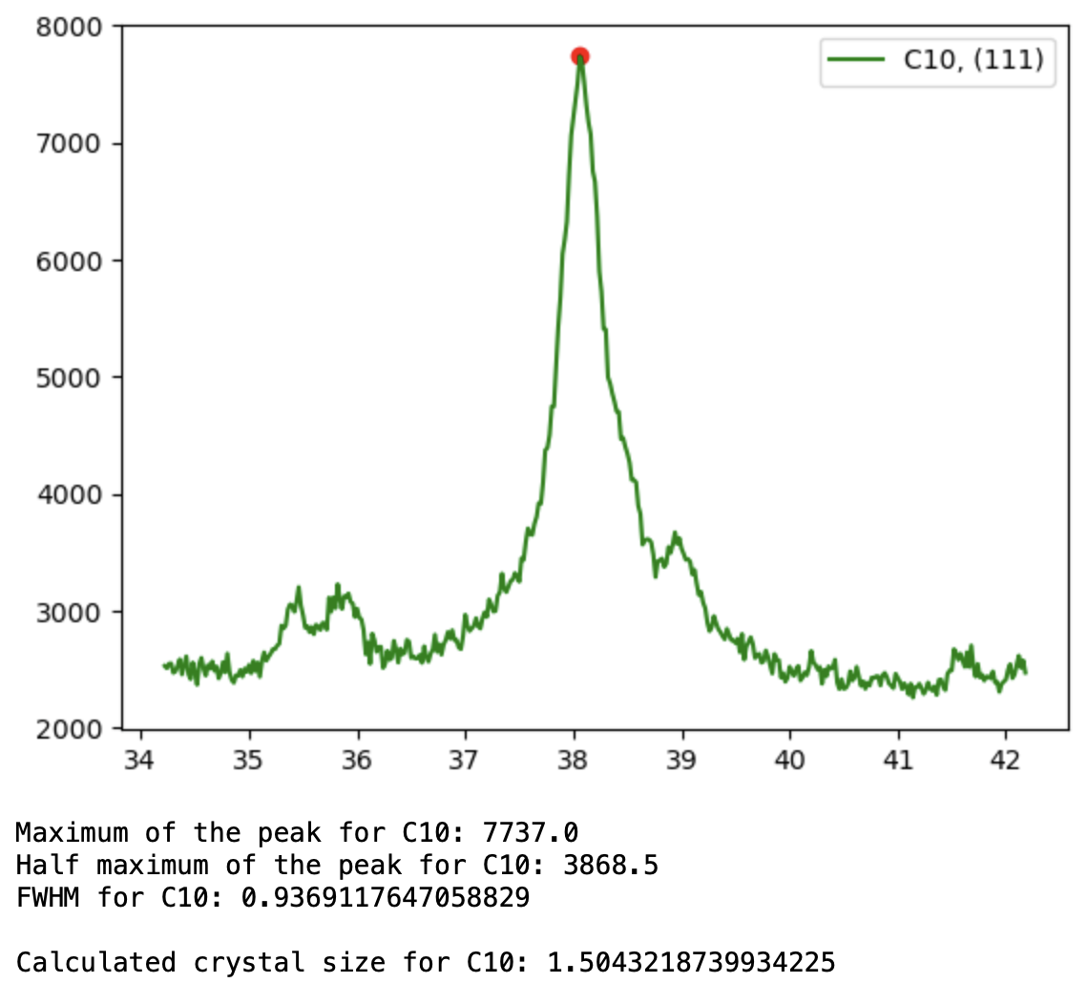
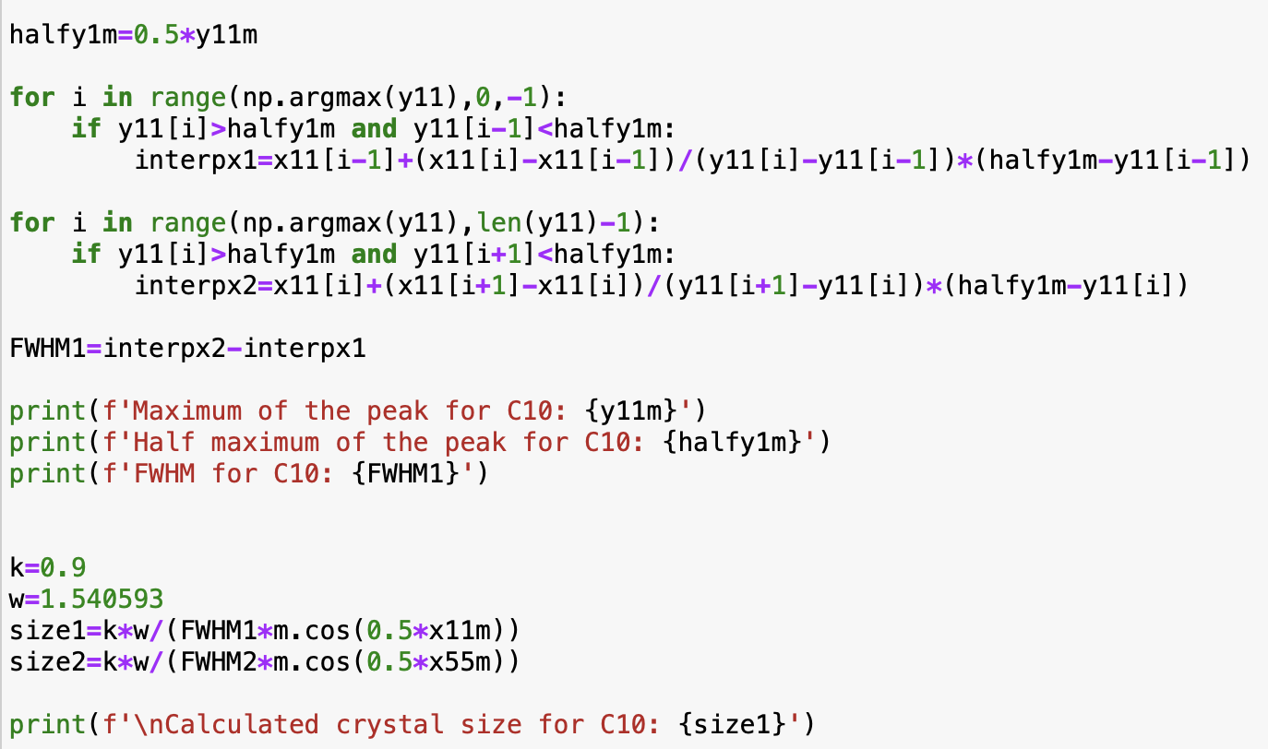
Notes:
So, from the peak with the highest intensity identified in the previous analysis, I divided the peak intensity by two.
[Since the exact point of half-maximum intensity may not be present in the dataset I obtained, I manually calculated using linear interpolation to locate this point.]
I figured out each of the exact x-coordinate by using linear interpolation between the surrounding y-values near half of the maximum y-value.
By subtracting these two x-values, I determined the FWHM, which was then used to calculate the crystal size.
[So I got crystal size of 1.5 for C10.]
[One thing to note is that the crystal size does not necessarily represent the particle size. Unless the particle is a single crystal, it typically contains multiple crystals, so the particle size is actually larger than the crystal size, including the silver particles I synthesized.]

Slide 8
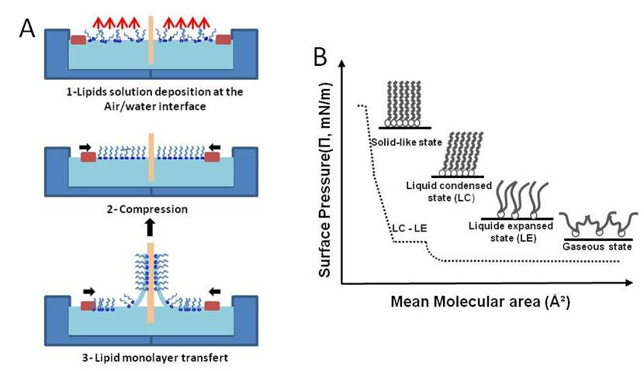
Isotherm Graph
Surface film pressure vs. area per molecule graph
Range of surface pressure for monolayer of silver nanoparticles
Uniform and controlled catalyst layer for efficiency of electrochemical reaction
Identification of monolayer
First and second curve observation required from obtained data
Notes:
[Ensuring the monolayer deposition is crucial as it maximizes cell efficiency and durability.]
The deposition process involved using an LB-trough instrument, which compresses the spread metals on the water surface at a specific surface pressure for deposition.
Before conducting the deposition, it was necessary to determine the surface pressure range for monolayer formation, which was obtained from an isotherm graph.
Typically, the initial curve of an isotherm represents the transition from gas to liquid. but, in my case with a solid metal solution, the first curve began when dispersed particles form the initial layer, and the second curve began when those monolayer particles forced to aggregate to form second layers.

Slide 9
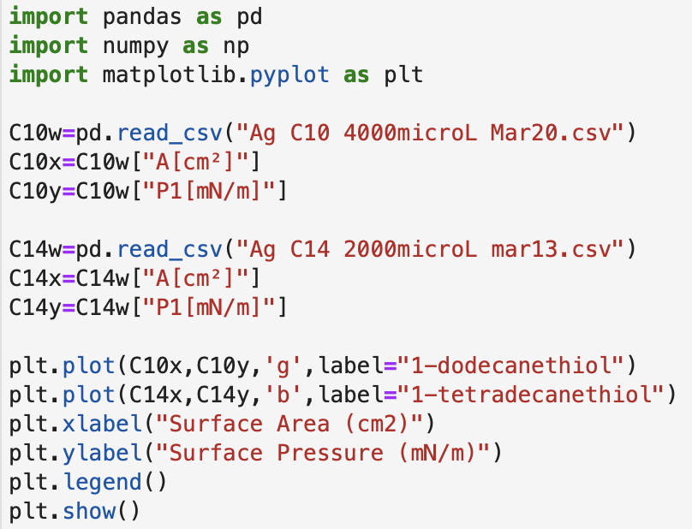
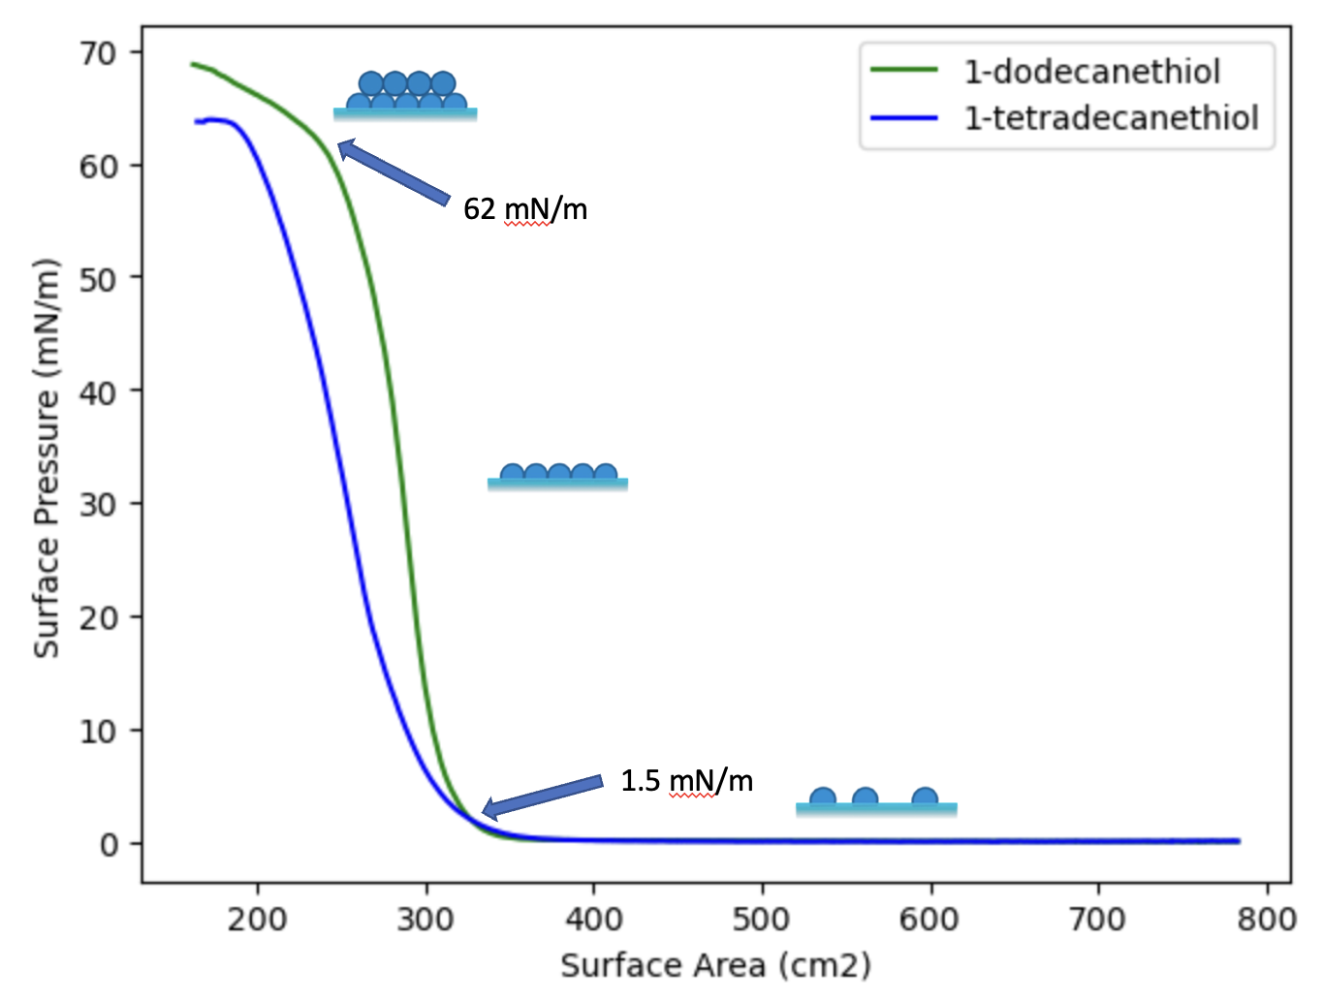
Monolayer formation at surface pressure of 1.5-62 mN/m
Notes:
Using isotherm data obtained from two silver solutions with different thiols, I extracted and separated the Surface pressure and area data and plotted them to identify the first and second curves.
The analysis revealed that both silver solutions with different stabilizers formed a monolayer within the surface pressure range of 1.5-62.

Slide 10
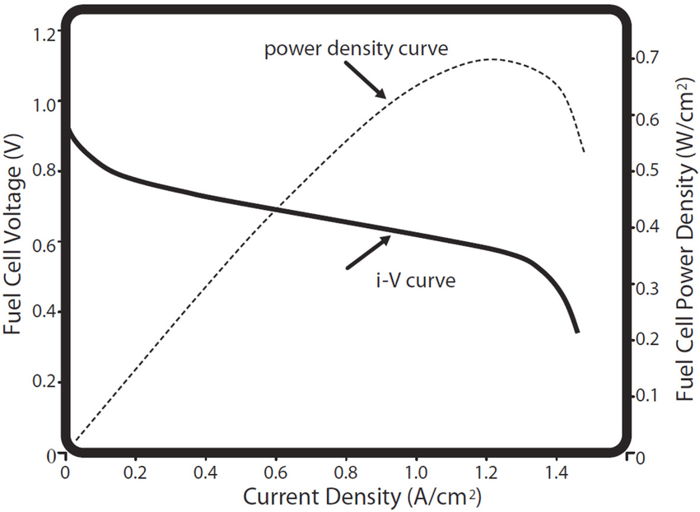
Polarization Curve and Power Output
Output test of membrane with catalyst deposited
Analysis of improvement of voltage and power output by applying Ag NPs deposition
Higher maximum power density
Slower voltage drop
Notes:
The goal of the research was to evaluate the performance of cells using silver deposited membranes to find if the silver could possibly showcase as a catalyst for PEMFC.
To achieve this goal, cell tests were conducted using uncoated membrane and coated membranes with two silver solution. I compared the voltage and power output results with those from uncoated plain membranes to see if the maximum power density increased and if the voltage drop was reduced due to the silver deposition.
10 mN/m of surface pressure

Slide 11
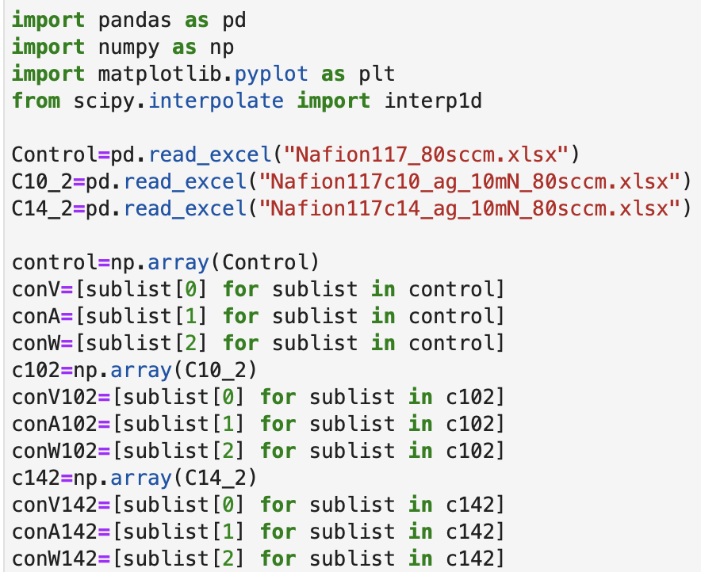
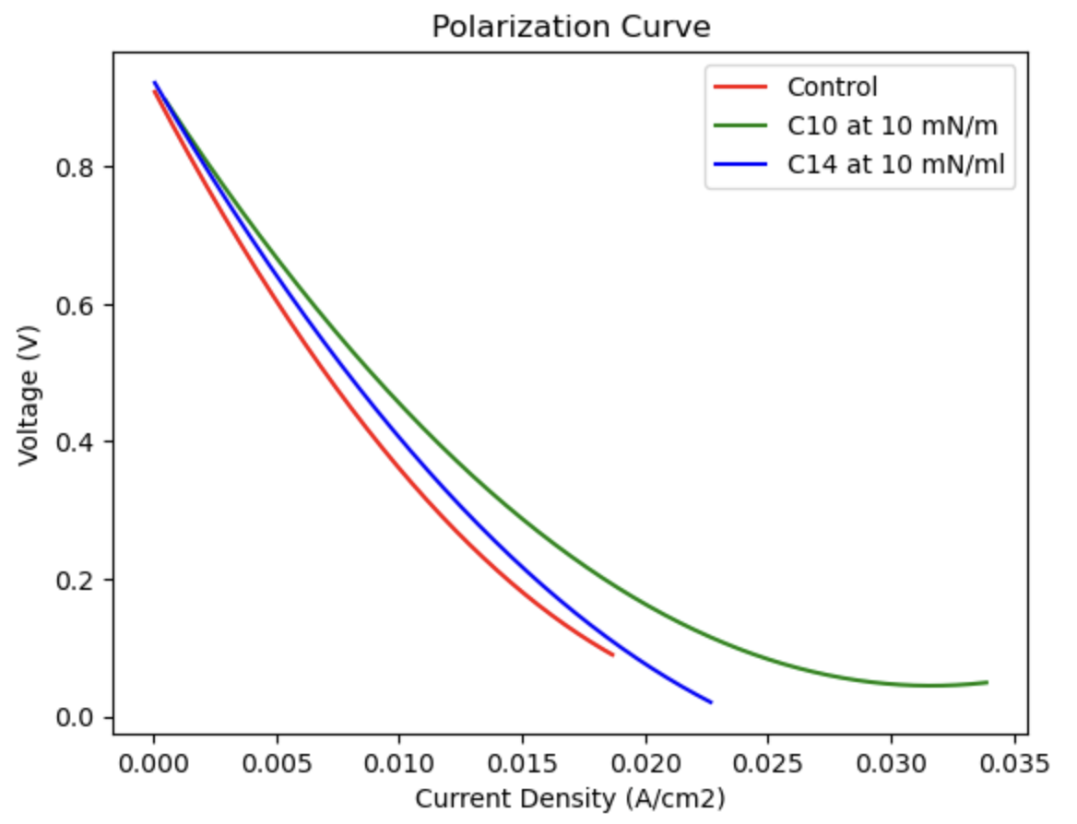
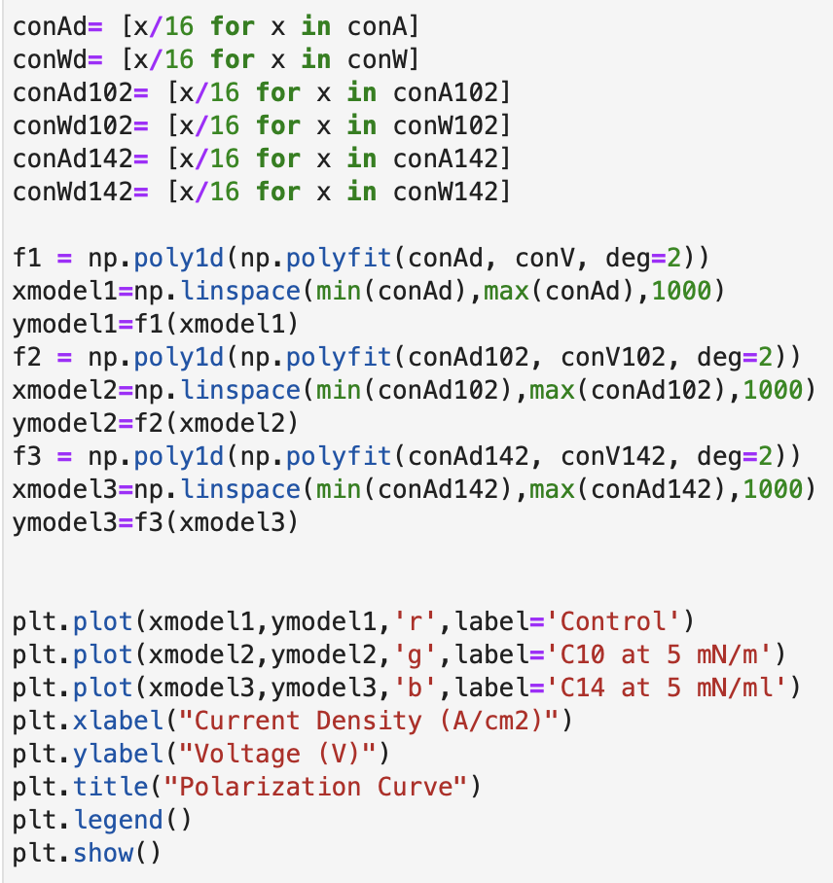
Notes:
I extracted voltage, current, and power data from my CSV file and organized them. Since I used membranes with an area of 16 cm², I normalized the current and power values by dividing them by 16 to obtain current and power density.
Subsequently, I plotted the voltage drop per current density using the poly1d function to create a smooth curve for data fitting. The resulting curve clearly demonstrated that the voltage drop was reduced and sustained for longer durations with both C10 and C14 depositions at a surface pressure of 10, compared to the results obtained from uncoated membranes.
Poly1d: polynomial curvefit function
Pokyfit: least squares polynomial fit (p(x) = p[0] * x**deg + ... + p[deg])

Slide 12
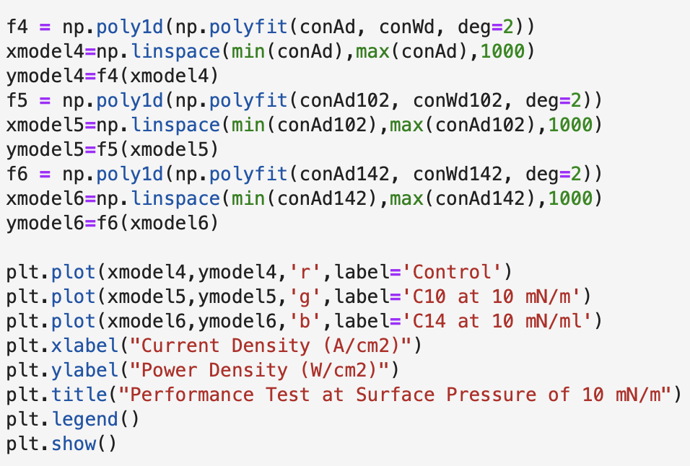
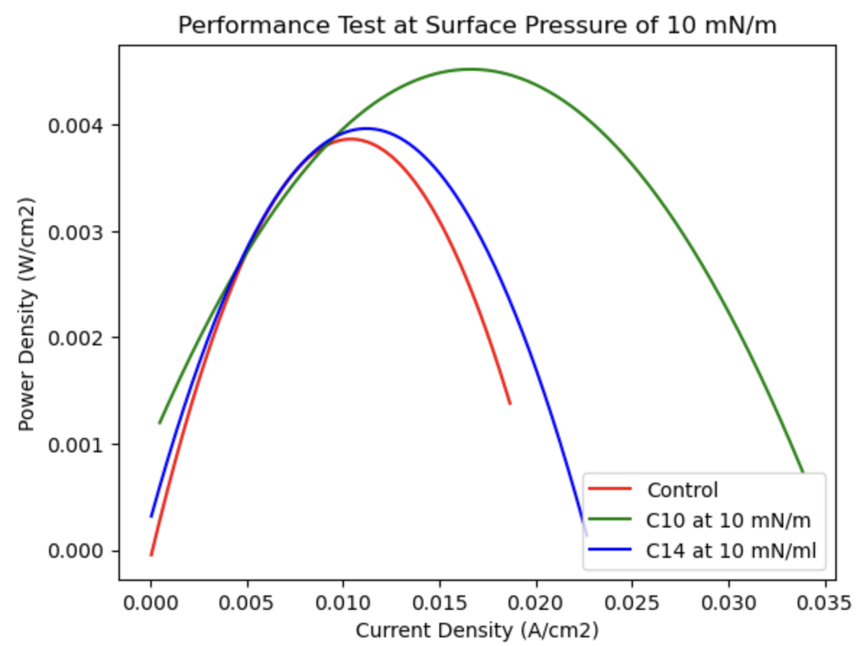
Notes:
I also used the poly1d function to plot power density and observe the enhancement caused by silver deposition.
The results clearly demonstrated enhancements with both C10 and C14, especially with C10 showed significantly higher power density. Additionally, the broader shape of the graph suggested a slower decline in power density, indicating better durability with silver deposition.

Slide 13
Conclusion
Successful confirmation of Ag NP formation
Identification of surface pressure range for monolayer formation of silver
SP at between1.5-62 mN/m
Performance and durability enhancement by silver deposition
10 mN/m of surface pressure
Overall best performance by Ag NPs with C10 (1-dodecanethiol)
Notes:
In conclusion, I successfully confirmed the formation of silver nanoparticles from the synthesis using XRD.
Also, I identified the surface pressure range where the silver nanoparticles form a monolayer for the deposition, which was between 1.5 to 62 mN/m.
Finally, from obtained performance data, the deposition of silver particles at a surface pressure of 10 successfully enhanced the overall power output,
especially the best results was observed with silver synthesized using C10.

Slide 14
References
Meng, Wei, et al. “Electrochemical behavior and surface conductivity of C/tic nanocomposite coating on titanium for PEMFC bipolar plate.” Metals, vol. 12, no. 5, 29 Apr. 2022, p. 771, https://doi.org/10.3390/met12050771.
Faye, Ndeye Rokhaya, et al. “Phase Behavior and Structure Properties of Supported Lipid Monolayers and Bilayers in Interaction with Silica Nanoparticles.” International Journal of Biological, Biomolecular, Agricultural, Food and Biotechnological Engineering, vol. 7, 2013.
Dilshad, Erum, et al. “Synthesis of functional silver nanoparticles and microparticles with modifiers and evaluation of their antimicrobial, anticancer, and antioxidant activity.” Journal of Functional Biomaterials, vol. 11, no. 4, 23 Oct. 2020, p. 76, https://doi.org/10.3390/jfb11040076.
Apps, Get link Facebook Twitter Pinterest Email Other. “Online Calculator for Crystallite Size & Lattice Strain from XRD Data.” Online Calculator for Crystallite Size & Lattice Strain from XRD Data, Blogger, 18 Mar. 2024, www.enote.page/2021/01/Crystallite-size.html.
O’Hayre, Ryan P. “Fuel cells for electrochemical energy conversion.” EPJ Web of Conferences, vol. 148, 2017, p. 00013, https://doi.org/10.1051/epjconf/201714800013.
Notes:
And these are the references I used. Thank you.

